Slide 1


Introduction to Python – Word Play
Mark Smith

Slide 2
Course outline
Lesson 2 – Types and Variables
Lesson 3 – Functions
Lesson 4 – Conditional Statements
Lesson 5 – Further Conditionals and Recursion
Lesson 6 – Functions with Return Values
Lesson 7 – Loops, Lists and Turtles
Lesson 8 – Snake
Lesson 9 – Review
Lesson 10 – Strings
Lesson 11 – Word Play

Slide 3
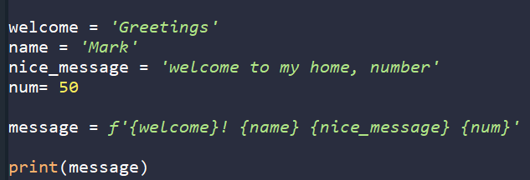
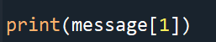
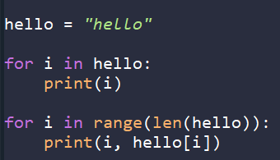
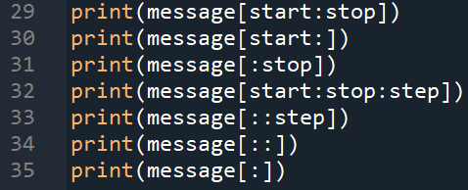
Last Week
What are f-strings?
Accessing String elements?
How long is a string?
What is string slicing?

Slide 4
This Week – Word play
Today we will learn:
How to look at every word possible
How to find certain words

Slide 5
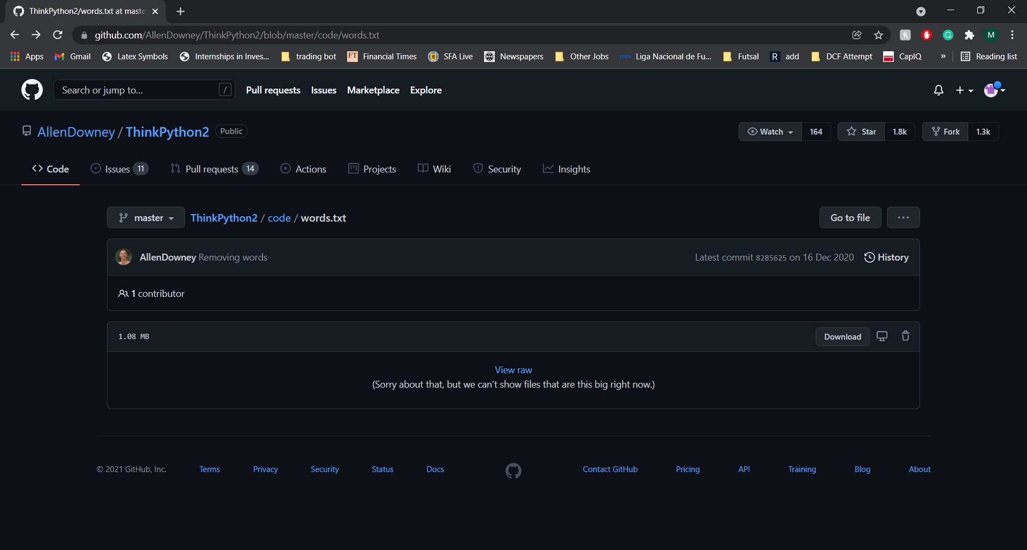
Moby Project
The Moby project is a list of 113,809+ words in the English language that are scrabble words
https://github.com/AllenDowney/ThinkPython2/blob/master/code/words.txt

Slide 6
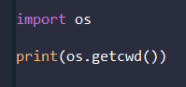
Moby project – reading the words
First, we need to download the text file and put it in the correct place for Python to find it

Slide 7
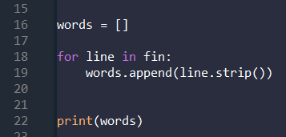
Moby project – using the words
Now, we need a way to use the words

Slide 8
Word play – exercises 1
Find all the words with more than 17 characters.
Pick 2 words you don’t know the definition of, let’s find out what they mean.
In 1939, Ernest Wright published a 50,000 word novel, Gadsby, without the letter ‘e’, which is the most common in the English language. Write a function that checks if a word has an ‘e’.
Then make a list with all the words with a letter ‘e’. What percentage of English words have a letter ‘e’?
Let’s make our code more general, change has_e to a new function has_letter(word, letter), that returns True if the word has the letter and false otherwise.
Now check other letters with our code, what is the second most common letter? What is the least common letter?

Slide 9
Word play – exercises 2
Write a function avoid that takes a word and a string of forbidden letters, and returns True if the word doesn’t use any of the forbidden letters. Then find four forbidden letters that exclude the fewest, the most, and all words.
What are all the words that don’t use any vowels? Let’s find the definition of some of them!
Write a function called uses_only that takes a word and a string of letters. Then returns True if the word contains only those letters.
Can you make a sentence with the letters ‘acefhlo’?
Can you make a sentence with the letters ‘gehac’?
Can you make a sentence with the letters of your name? What about your full name?

Slide 10
Word play – exercises 3
Write a function called uses_all that takes a word and a string of required letters, it should return true if the word uses all the required letters at least once.
How many words are there that use all the vowels?
How many words are there that use all the letters of your name? Can you make a sentence with them?
A word is called abecedarian if its letters are in alphabetical order, write a function that returns true if the word is abercedarain.
How many words are in alphabetical order?
Can you make a sentence with them?

Slide 11
End of class
This week we have looked at:
Reminder of what strings are
What are f-strings
How do we access the elements of a string
How long is a string?
What is string slicing?

